Slide 1
HOUSE PRICE PREDICTION
Submited By:
Sayan Kumar Bhunia

Slide 2
OUTLINE
Introduction
Problem statement
Project Specification
Dataset
Pipeline
Data Cleaning
Feature Engineering
Outlier Detection
Outlier Removal
One Hot Encoding
Feature scaling
Model Creation
cross validation
Grid Search cross validation
Key metrics
Conclusion

Slide 3
INTRODUCTION
For this project, I have to predict house price for a US-based housing company named Surprise Housing which has decided to enter the Australian market. The company uses data analytics to purchase houses at a price below their actual values and flip them at a higher price.
Regression algorithm is used to create a model with a great accuracy score.

Slide 4
PROBLEM STATEMENT
A US-based housing company named Surprise Housing has decided to enter the Australian market. The company uses data analytics to purchase houses at a price below their actual values and flip them at a higher price. For the same purpose, the company has collected a data set from the sale of houses in Australia. The data is provided in the CSV file below. The company is looking at prospective properties to buy houses to enter the market. You are required to build a model using Machine Learning in order to predict the actual value of the prospective properties and decide whether to invest in them or not. For this company wants to know:
• Which variables are important to predict the price of variable?
• How do these variables describe the price of the house

Slide 5
PROJECT SPECIFICATION
Required to build a model the price of houses with the available independent variables. This model will then be used by the management to understand how exactly the prices vary with the variables. They can accordingly manipulate the strategy of the firm and concentrate on areas that will yield high returns. Further, the model will be a good way for the management to understand the pricing dynamics of a new market.
We are using Machine Learning Algorithm to create a predictive model.
Regression algorithm is used to train and test the model in our project.

Slide 6
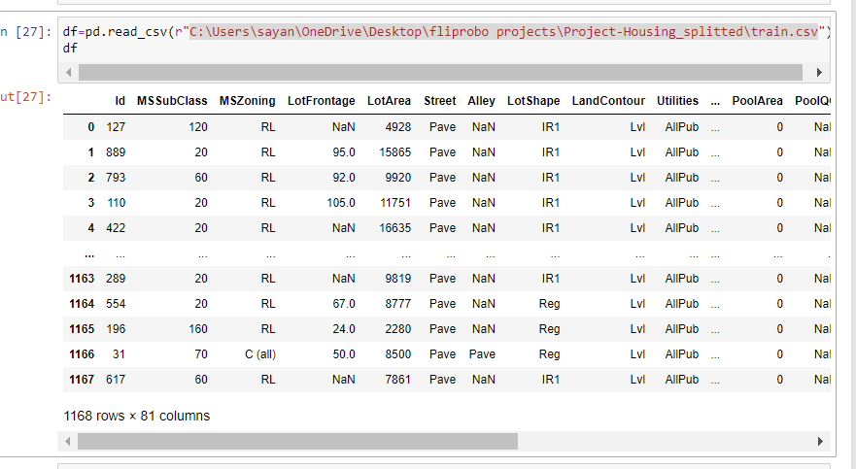
DATASET
Link of the dataset-
C:\Users\sayan\OneDrive\Desktop\fliprobo projects\Project-Housing_splitted\train.csv
I am using CSV (comma-separated values) format file which is having 1168 rows × 81 columns.

Slide 7
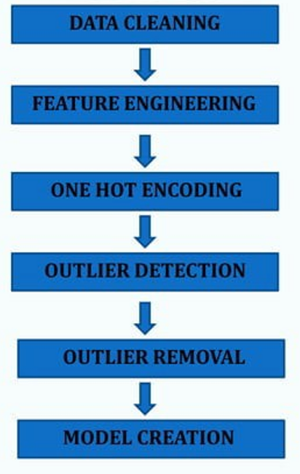
PIPELINE

Slide 8
DATA CLEANING
The main aim of Data Cleaning is to identify and remove errors &
duplicate data, in order to create a reliable dataset.
The process of data cleaning is done by usinga very famous library pandas.
Initially, those columns/features are dropped from dataset which are not important for prediction..
The rows having a null value in any colurnns are dropped from dataset.
The columns having characters as well as integer values are converted into integer values only.
Many more data cleaning techniques are used to improve the quality of dataset.

Slide 9
FEATURE ENGINEERING
Feature engineering is the process of using domain knowledge to extract features from raw data via data mining techniques. These features can be used to improve the performance of machine learning algorithms. Feature engineering can be considered as applied machine learning itself.
Dimensionality reduction techniques are used in dataset to reduce those rows which are not very much important for predicting target value.

Slide 10
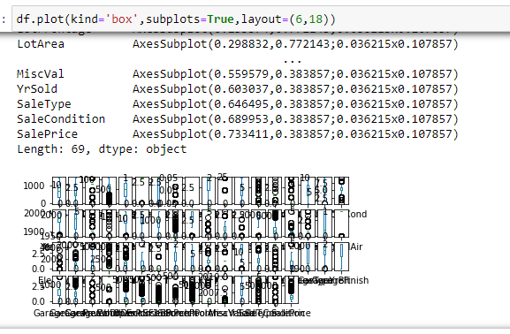
OUTLIER DETECTION
In simple words, an outlier is an observation that diverges from an overall pattern on a sample.
There are many types of outlier detection techniques such as Z-Score or Extreme Value Analysis, Probabilistic and Statistical Modeling, Information Theory Models, Standard Deviation etc.
In the following case box plot is used to detect outliers.

Slide 11
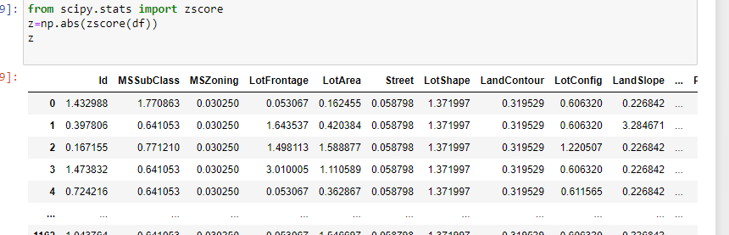
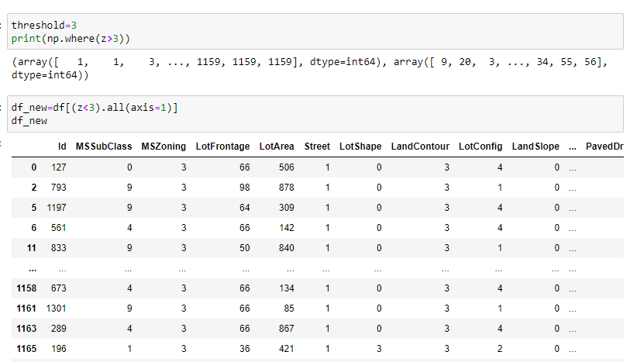
OUTLIER REMOVAL
After detecting the outlier, correct that errors if possible and if you can not fix it, then remove that observation.
In our dataset, we observed variations in the relation between values of some attributes.
So that these type of rows are dropped from the dataset.

Slide 12
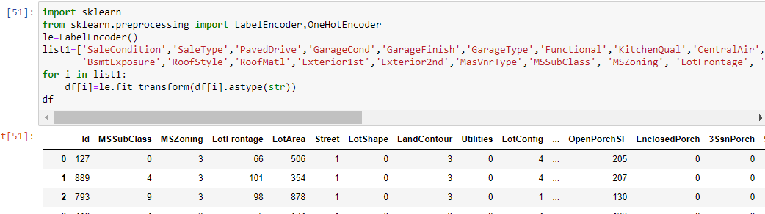
ONE HOT ENCODING
This technique is used to convert the categorical variables into numeric values.
As we can see there are 3 object in this dataset object type columns present so we will encode it into (int) format.
Apply Label Encoding, if number of categories in a categorical variable is equal to 2.
Apply One-Hot Encoding, if number of categories in a categorical variable is greater than 2.

Slide 13
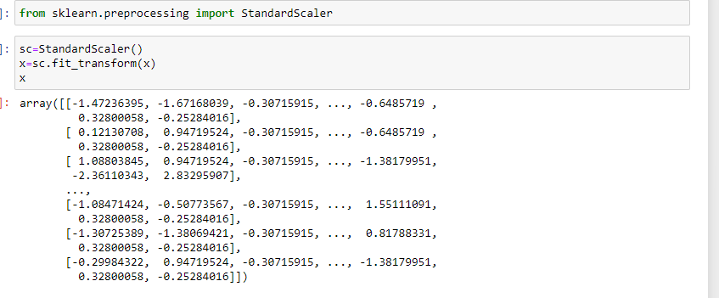
FEATURE SCALING
Feature Scaling ensures that all features will get equal importance in supervised Regression models. Standard scaler was used to scale all features in the data.

Slide 14
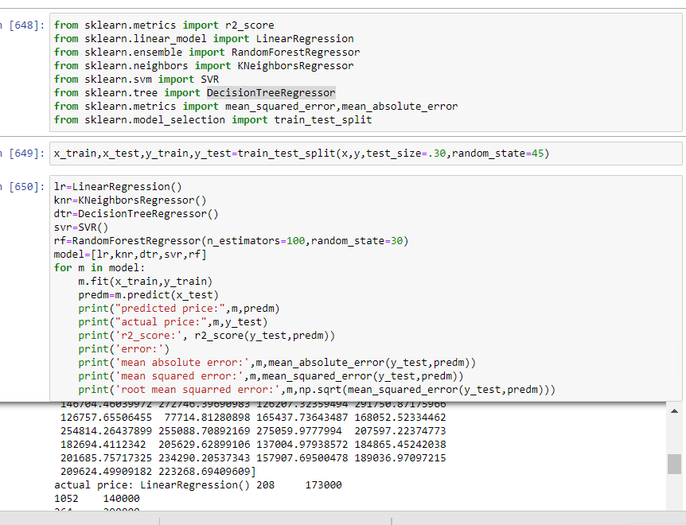
MODEL CREATION
The process of modeling means training a machine learning algorithm to predict the labels from the features.
LinearRegression
RandomForestRegressor
KNeighborsRegressor
SVR
DecisionTreeRegressor
Lasso and Ridge

Slide 15
CROSS VALIDATION
Cross-validation is a statistical method used to esti1nate the skill of machine learning models.
It is commonly used in applied machine learning to compare and select a model for a given predictive problem because it is easy to understand, easy to implement, and results in skill estimates that generally have a lower bias than other methods.

Slide 16
GRIDSEARCH CROSS VALIDATION
This is a technique which is used to find the best algorithm for modeling and give best parameters as well.
We applied grid search cross validation method on our dataset with Random Forest Classification.

Slide 17

KEY METRICS
Selection of a model requires evaluation and evaluation requires a good metric. This is indeed important. If we optimize a model based on incorrect metric, then, our model might not be suitable for the business goals.
We have a number of metrics, for example mean absolute error ,mean squared error, root mean squared error etc.

Slide 18
CONCLUSION
Key aspects of building successful classifier are:
Selecting correct data according to the purpose or problem statement.
Proper processing and understanding of the data
Selecting the model and optimizing the model.
In this project I have dealt with outliers and using z score I removed those outliers for better accuracy.
I have used label encoder for encoding object data type into int datatype as machine doesn’t understand object type data.
I have used simple imputer for filling up missing values.
I have used three classification model and found Random Forest Classifier to be the best fit. It is giving 91% accuracy.

Slide 19
THANK YOU

